Slide 1
We can read sight words.

Slide 2
or

Slide 3
one

Slide 4
had

Slide 5
by

Slide 6
words

Slide 7
but

Slide 8
not

Slide 9
what

Slide 10
all

Slide 11
were

Slide 12
we

Slide 13
when

Slide 14
your

Slide 15
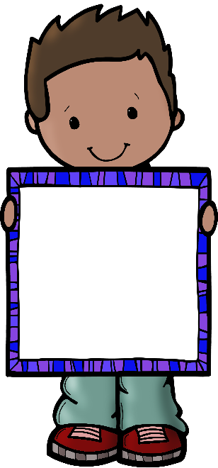
can

Slide 16
said

